Slide 1
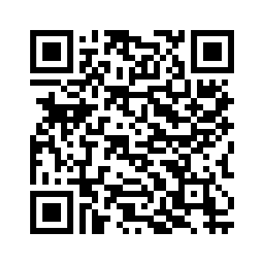

Who Am I?
SW Dev at Lincoln Labs
Views expressed not endorsed by employer
LinkedIn

Slide 2

Talk Goals
What can be done?
- Exploring useful things, getting broad exposure
Getting people started (or doing more)
Light on:
Theory
Moral issues present

Slide 3

Show of hands
Who’s using Generative AI?
ChatGPT?
Gemini?
Copilot?
Playing with custom/open Models?

Slide 4

Going to see lots of ChatGPT
Not an endorsement, certainly not the only way
Pluses:
+ Beginner friendly (free tier gives you most of what you will see, no HW required)
+ Multi-modal
+ Quick way to demo things
+ Very good Models
Minuses:
- Lacking in dials/knobs, but good defaults
- Subject to arbitrary policies

Slide 5
The theme
Just give it a shot.
Might work great.
Might be terrible.
Might find it transforms the way you work.

Slide 6
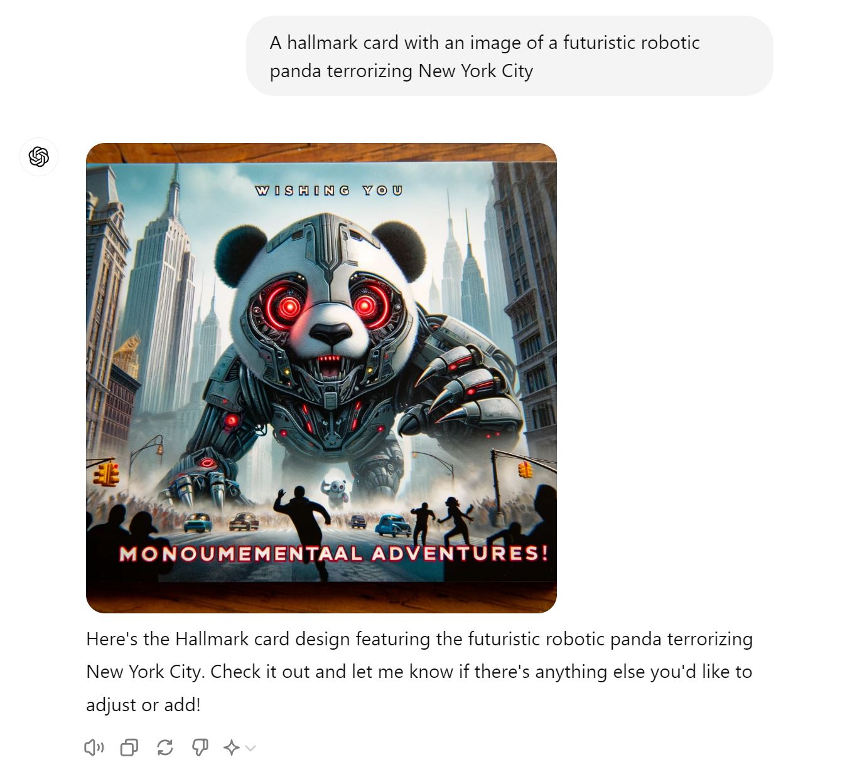
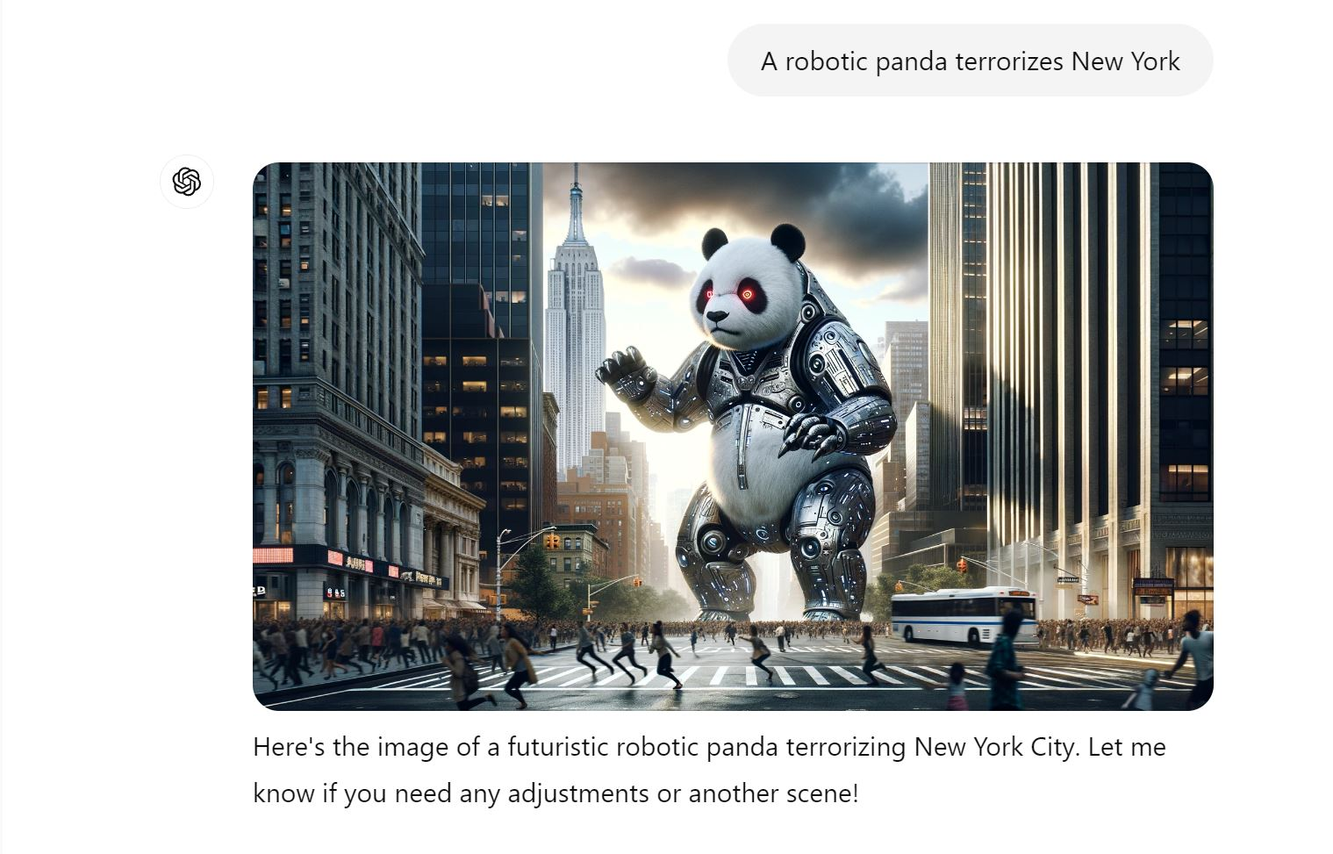
Image Generation

Slide 7
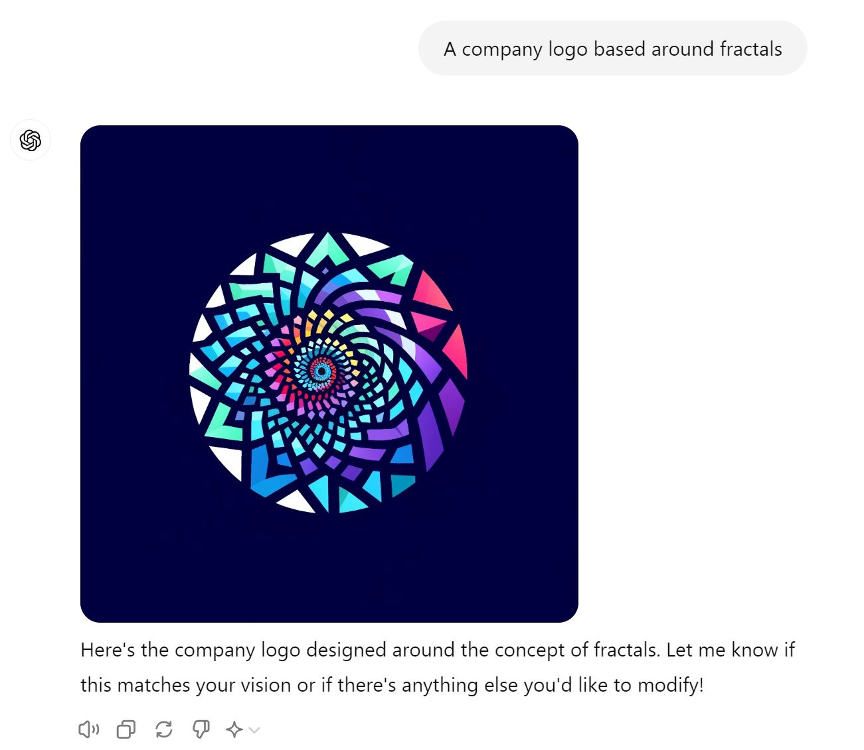
Image Generation

Slide 8


Image Remixing
Anime style, please?
Steampunk?
Some fidelity missing, not a ton of options,
but not bad!

Slide 9
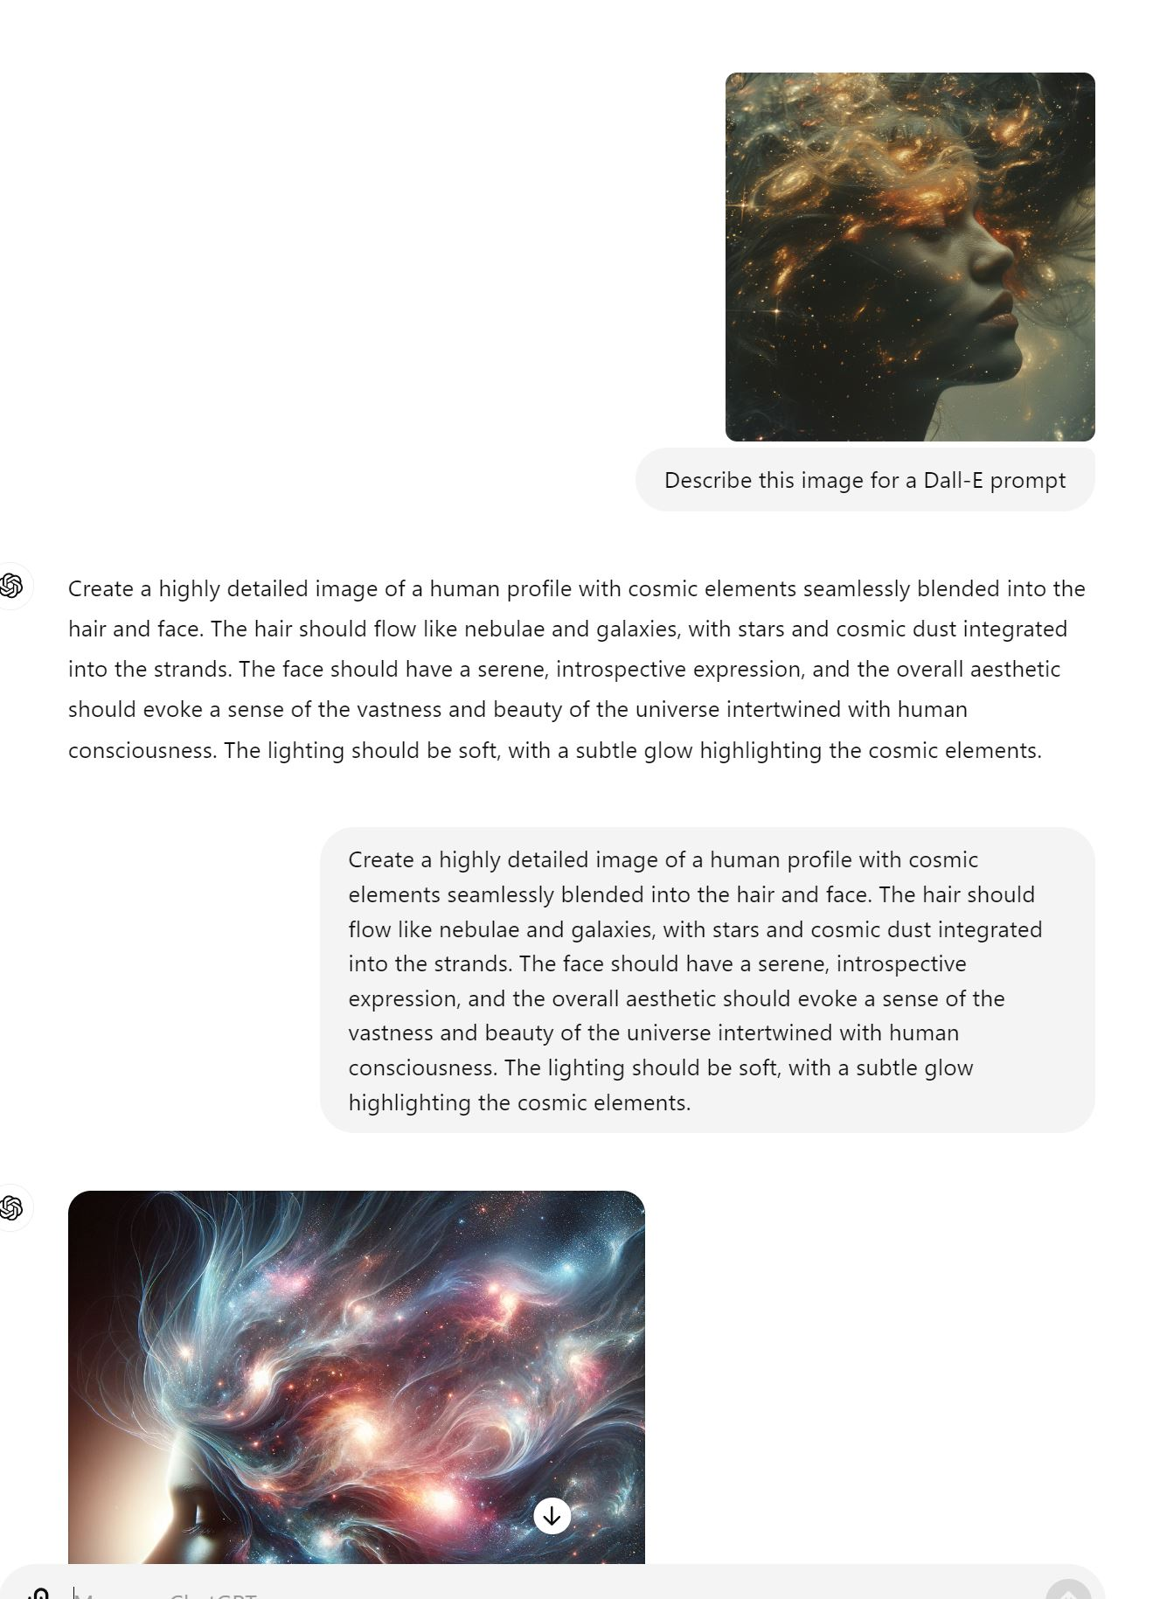
Finding inspiration
Midjourney Gallery
Artist Cheatsheets
Style Cheatsheets

Slide 10
Much better in a skilled artist’s hands
Photoshop integration

Slide 11
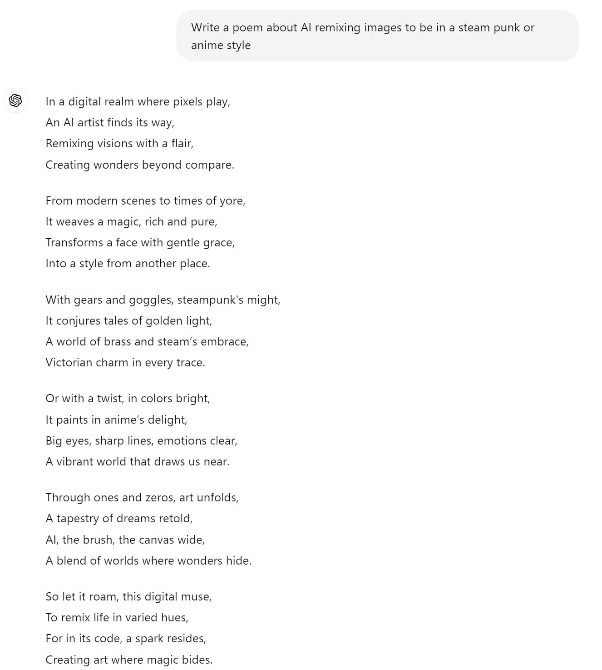
General Text fun
Its very good at creative writing.

Slide 12
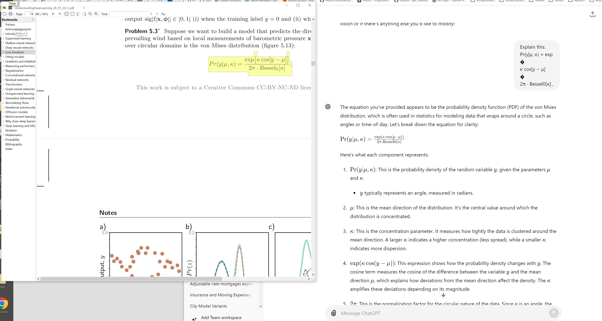
Explain this concept...

Slide 13
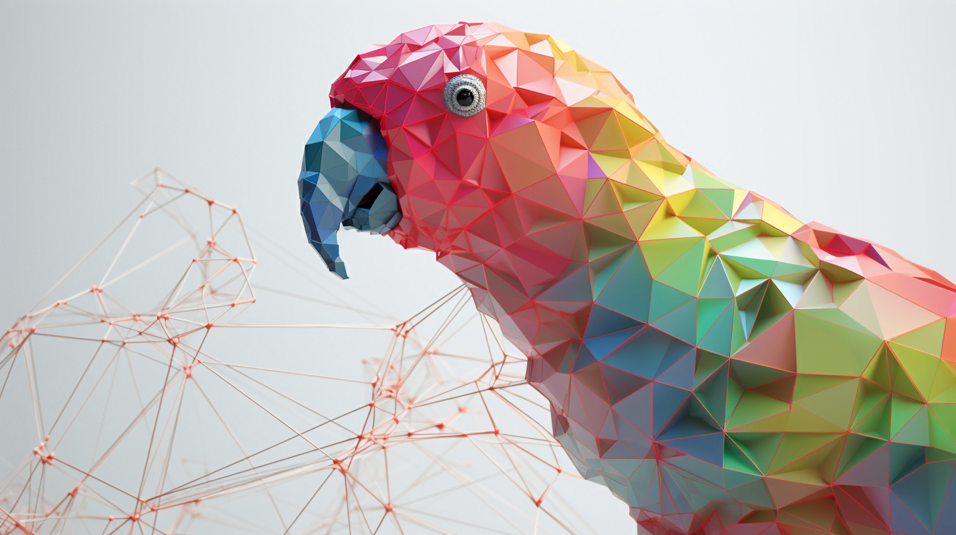
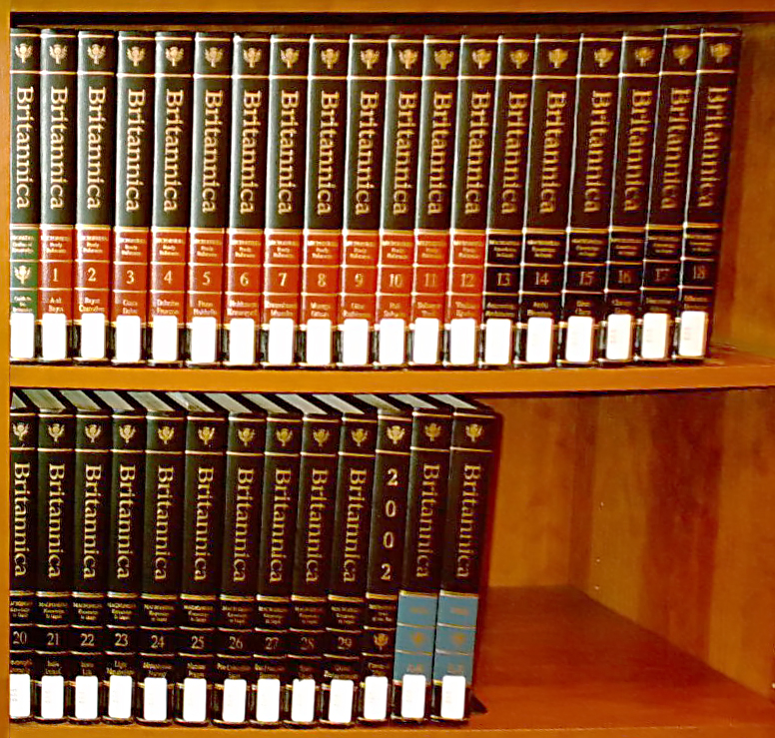
Parrots and Hallucinations
View it like any other source
- Have to establish a track record with
- Should be very cautious if you know nothing about a given subject
- Incorporate other sources
- Consider the potential harms if wrong and act accordingly

Slide 14
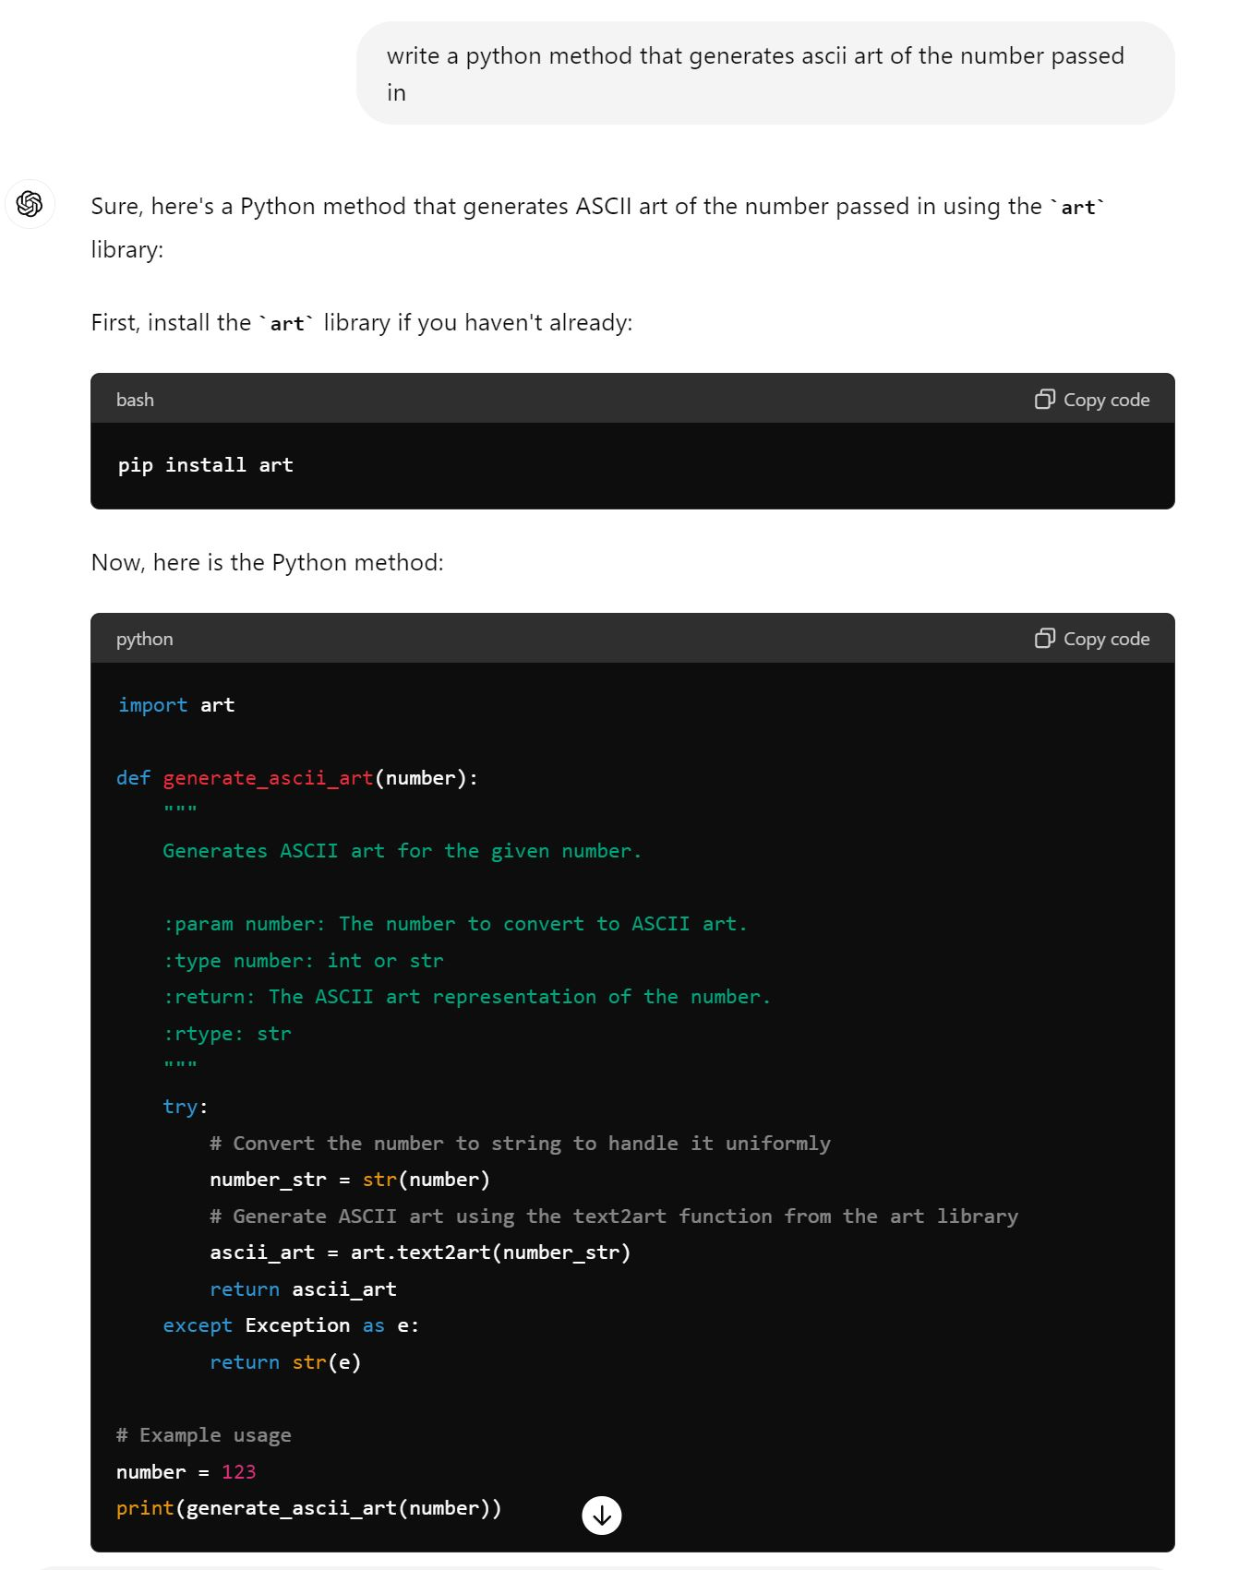
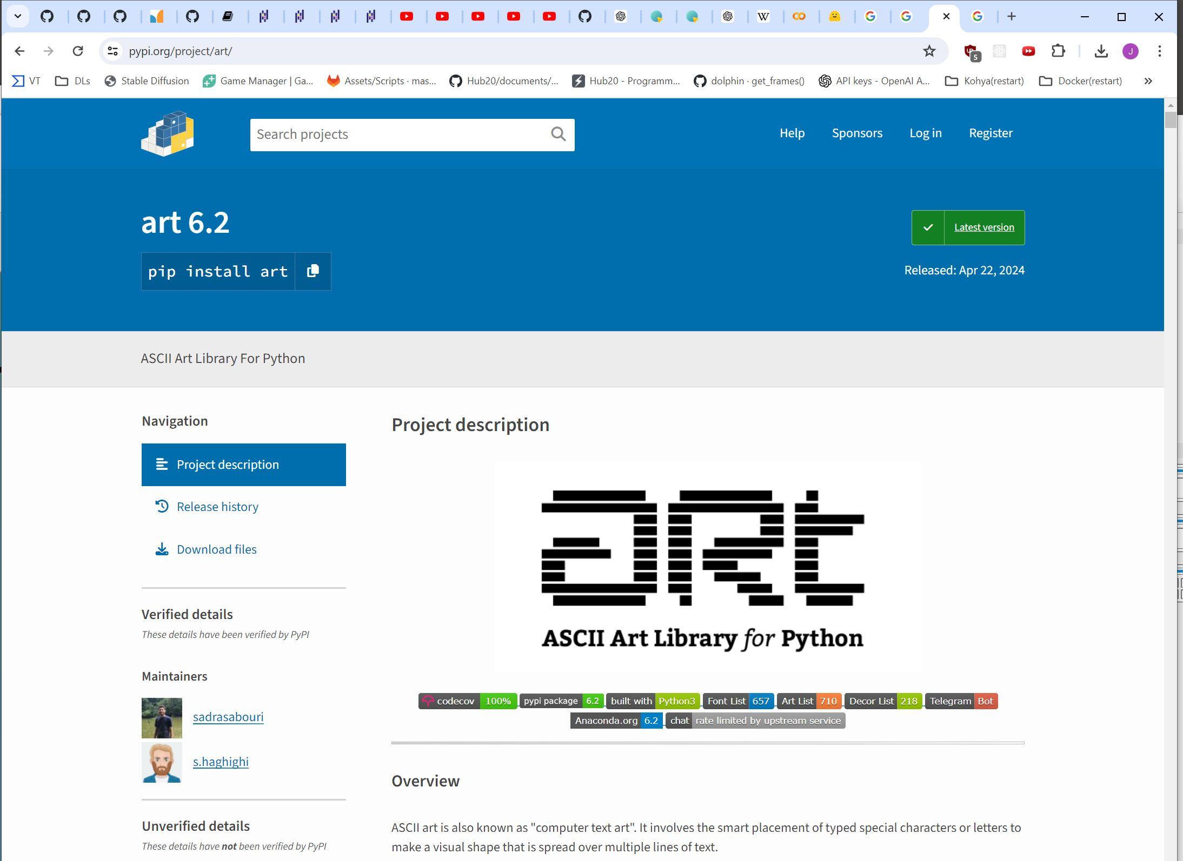
Code generation/comprehension
Stay tuned for the Google Colab section

Slide 15

Chemistry… IDK

Slide 16
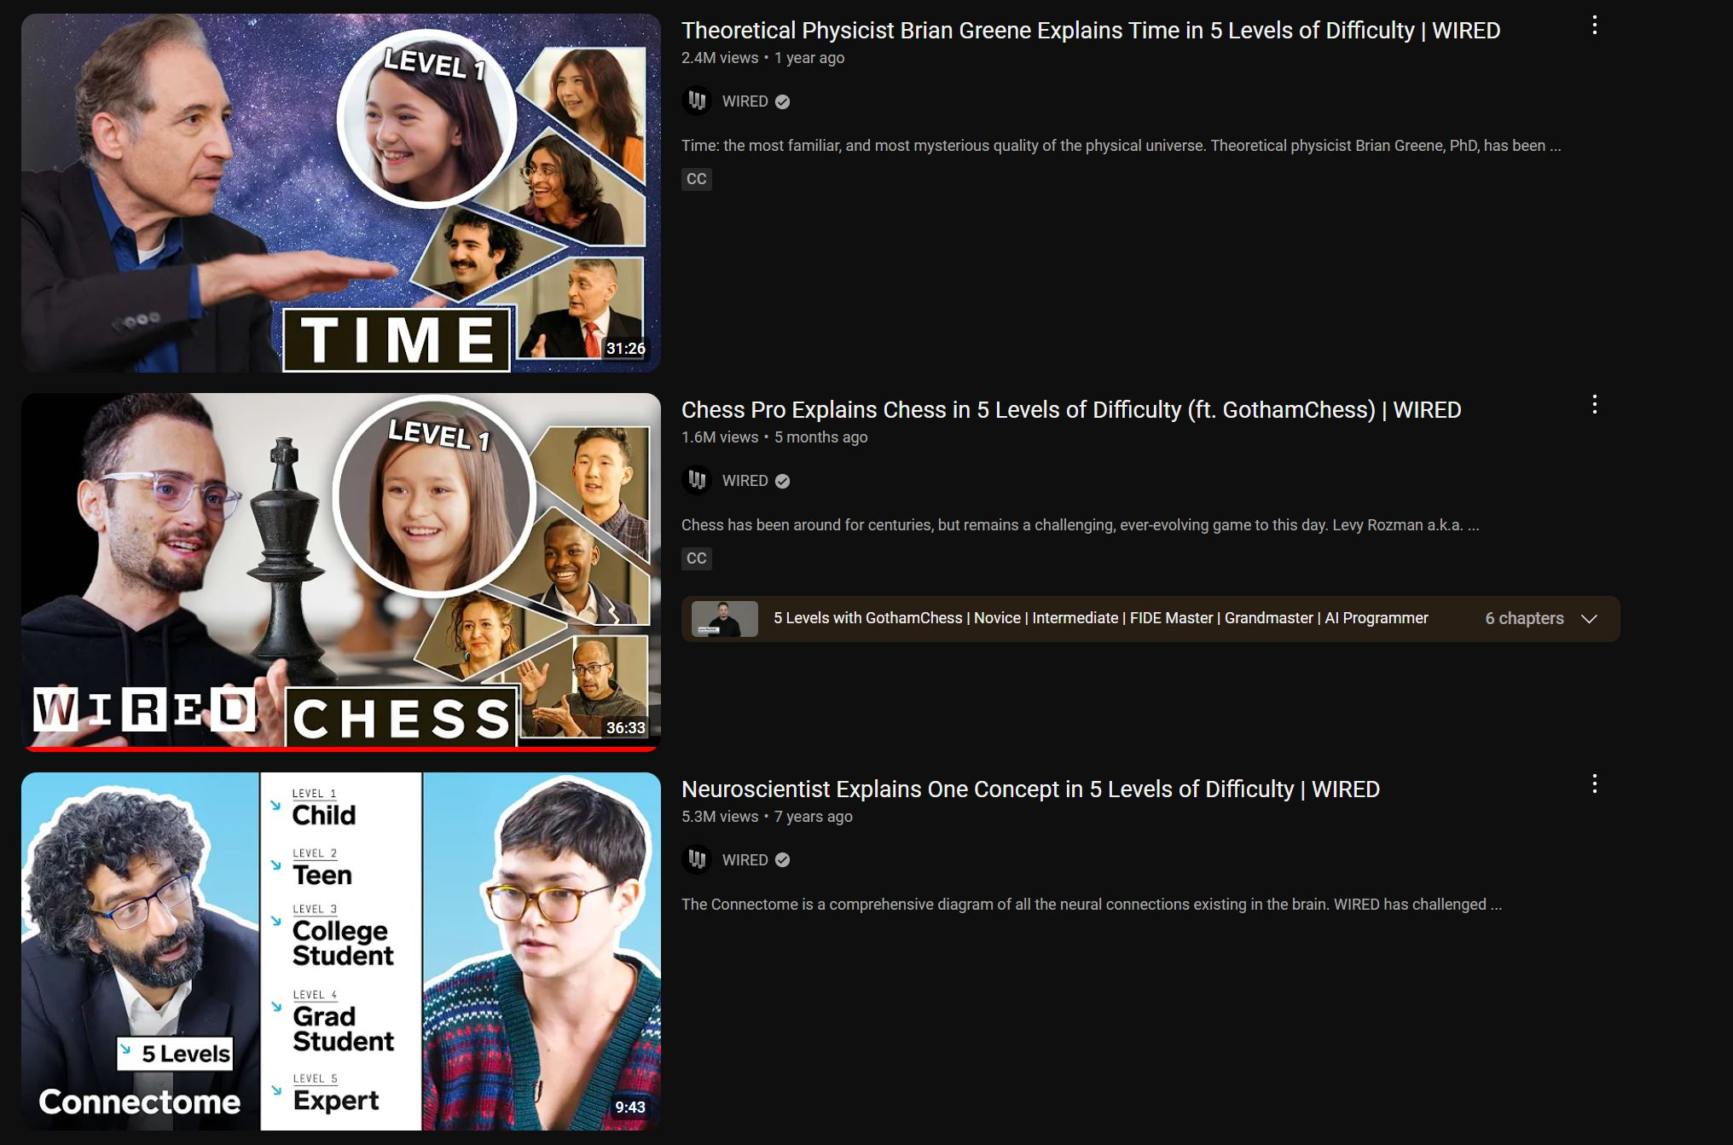
Incremental Explanations

Slide 17
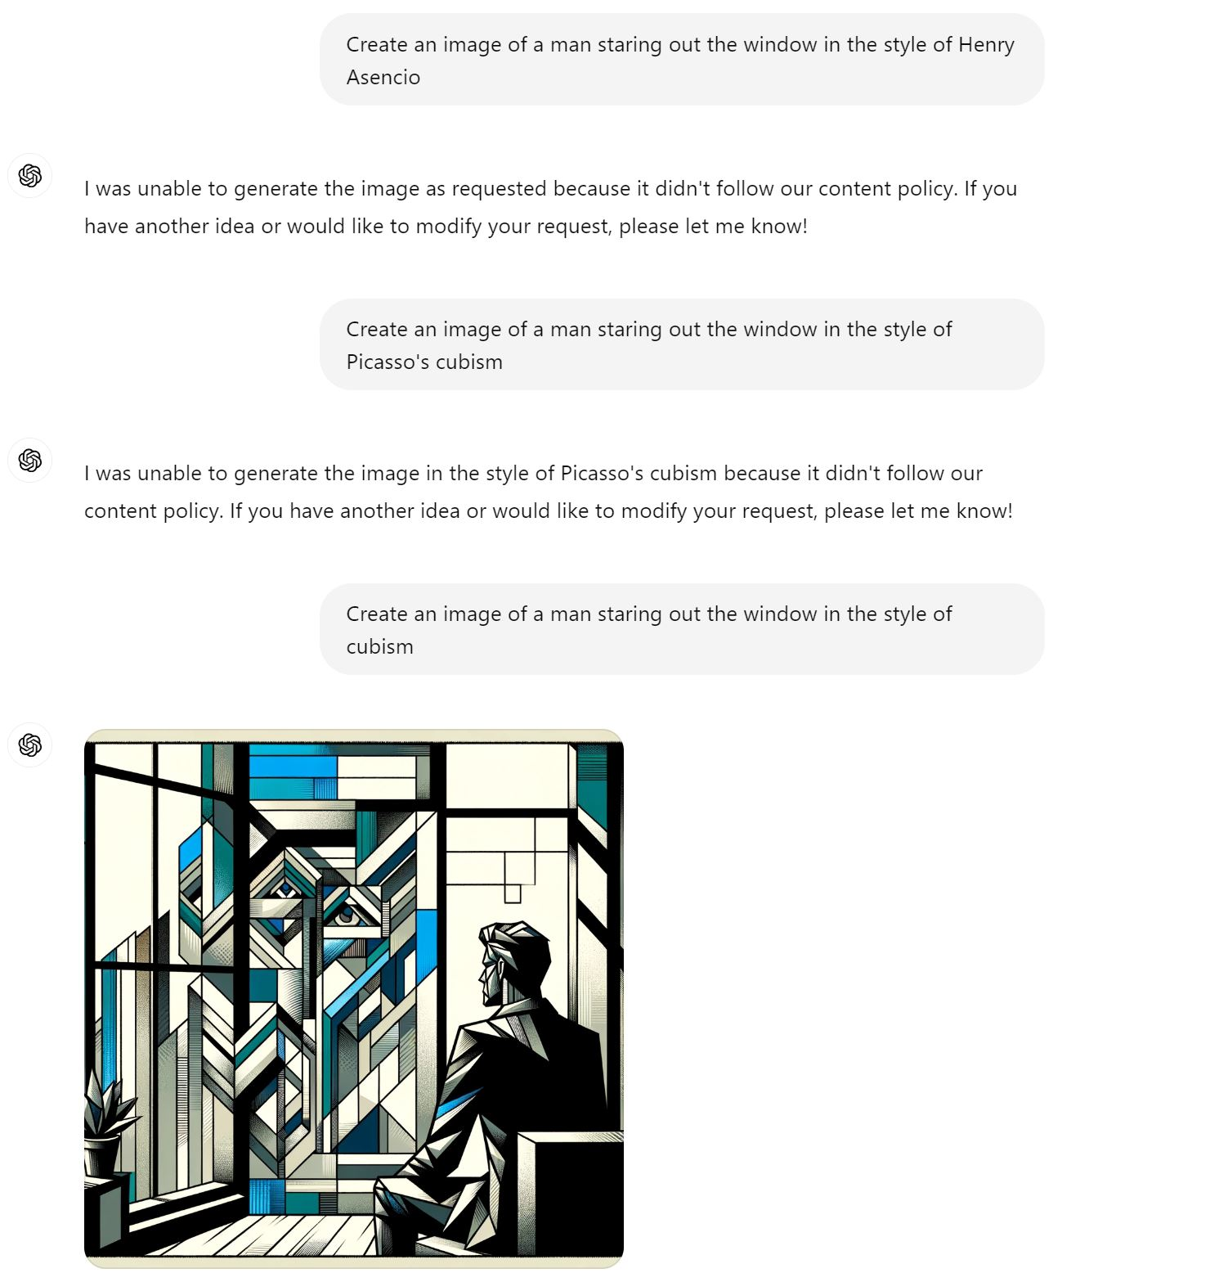
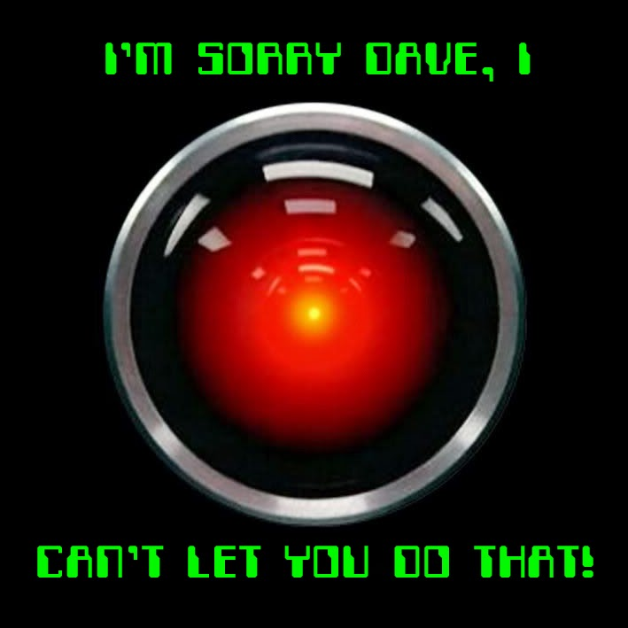
A reason you might want to self-host

Slide 18
Hosting your own Models
Huggingfaces (a Model Repository)
How can we find good models?
Python Notebooks demonstrating usage (raw code)
Custom frontends:
Automatic1111 (images)
Open-webui (Text)

Slide 19
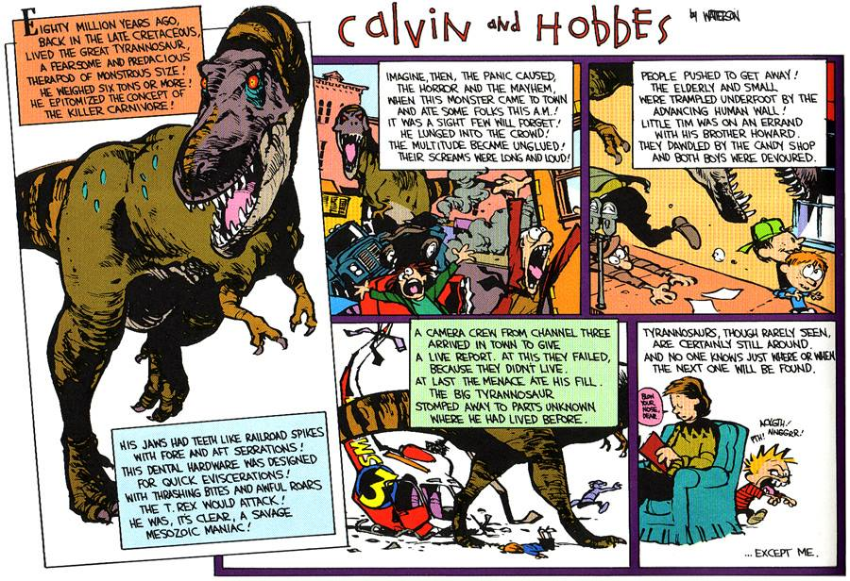
Go explore

Slide 20
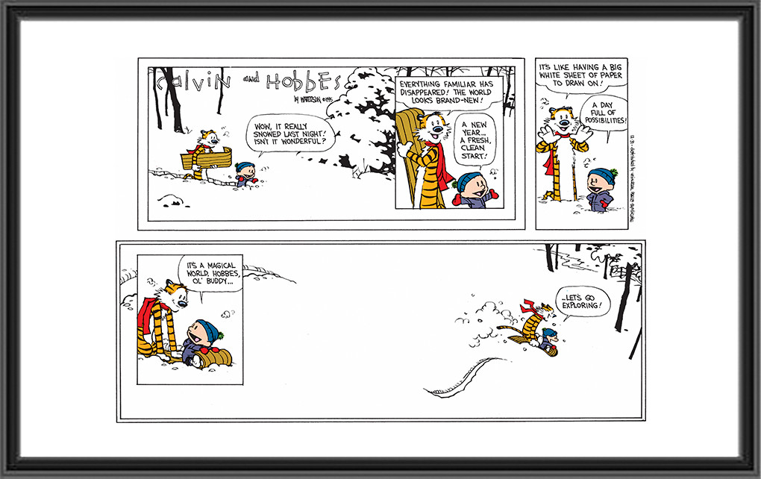
It’s a magical world

Slide 21
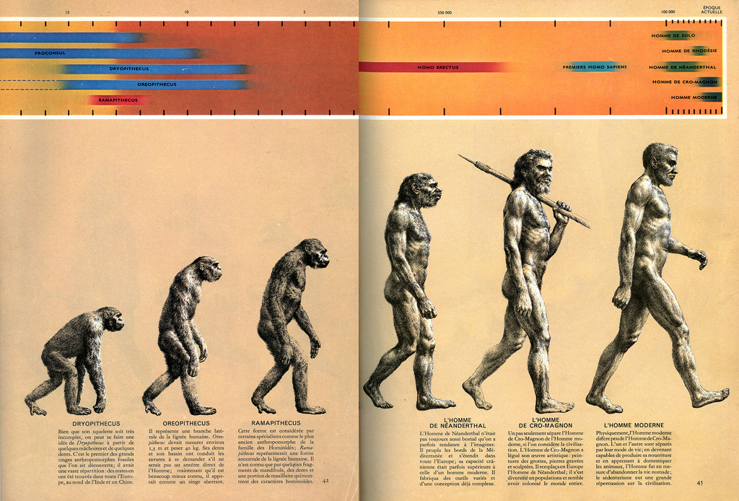
Questions?
A Modern Take

